Slide 1
DIGITAL LOGIC DESIGN
EE(109)
LECTURE-30
DATE: 16TH APRIL, 2018

Slide 2
Chapter No:7
Latches and Flip Flop

Slide 3
TOPICS
1. Latches
2. Flip-Flops
3. Flip-Flop Operating Characteristics
4. Flip-Flop Applications

Slide 4

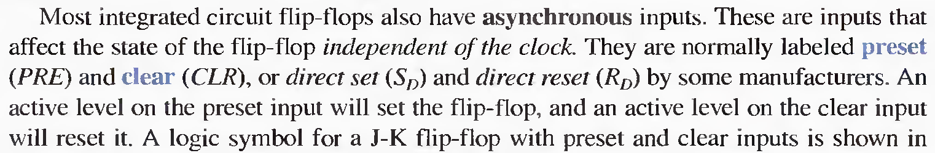
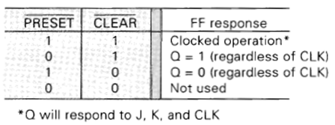
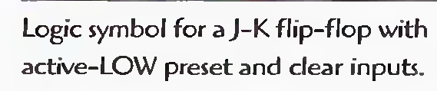
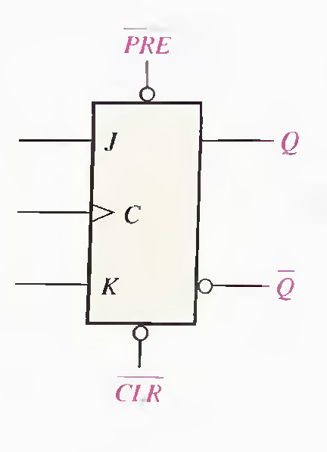
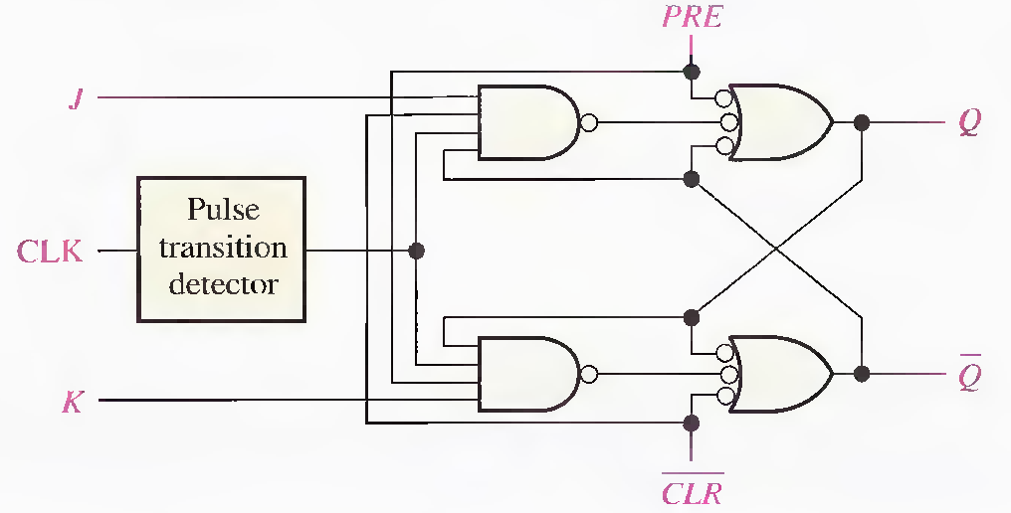

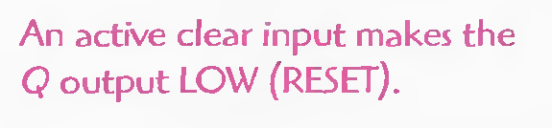

Slide 5
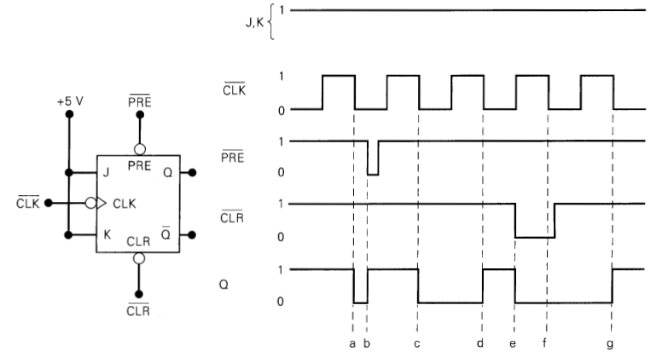
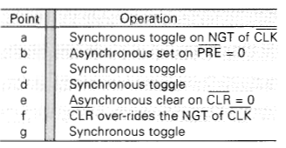

Slide 6

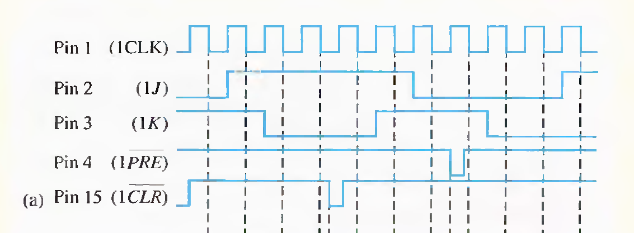


Slide 7

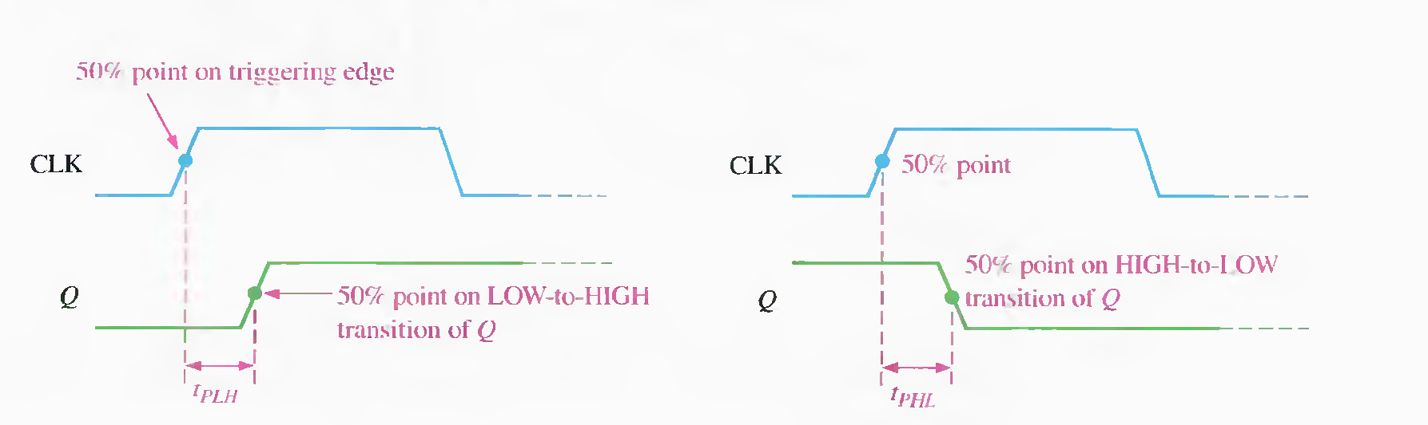

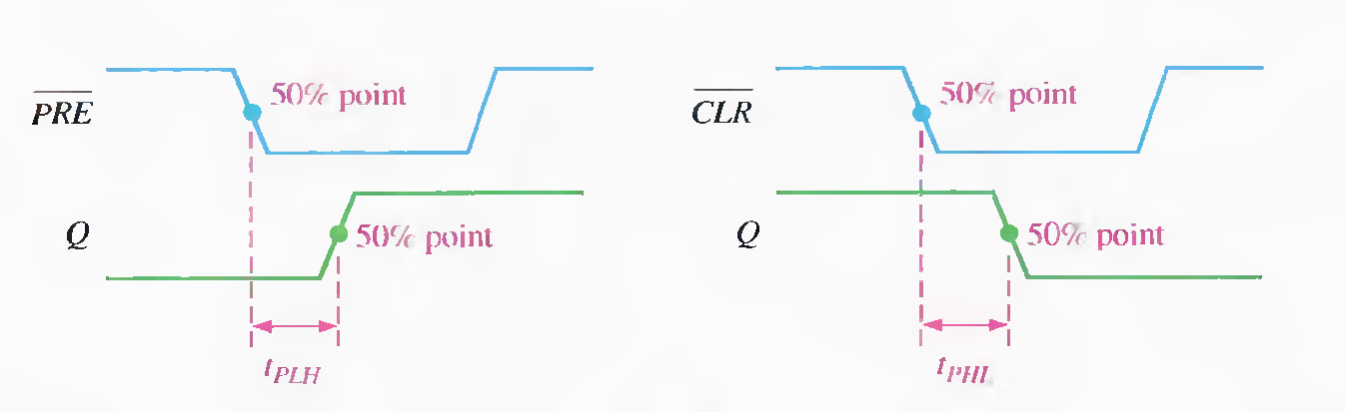

Slide 8

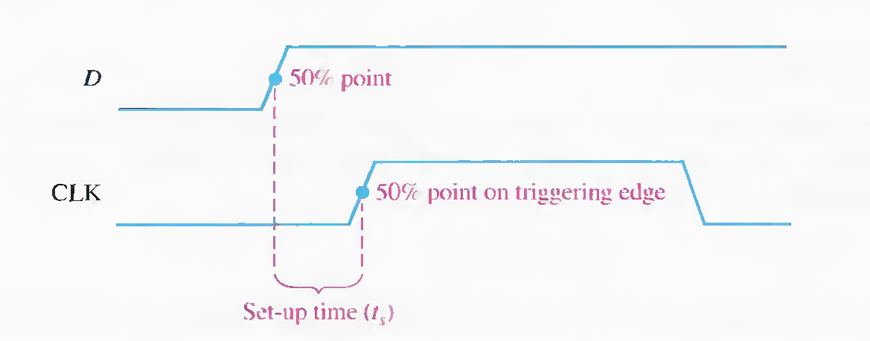

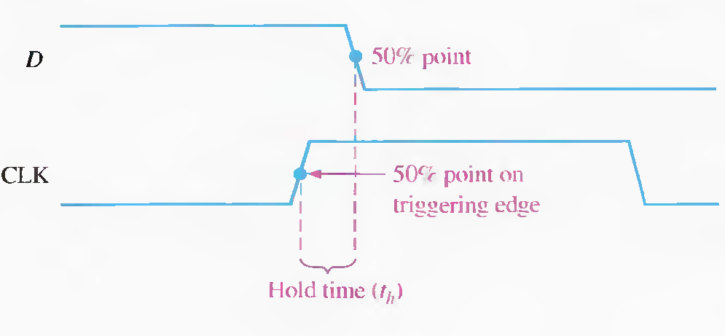
The set-up time (ts) is the minimum interval required for the logic levels to be maintained constantly on the inputs (J and K, or Sand R, or D) prior to the triggering edge of the clock pulse in order for the levels to be reliably clocked into the flip-flop.
for a D flip-flop.
The hold time (th) is the minimum interval required for the logic levels to remain on the inputs after the triggering edge of the clock pulse in order for the levels to be reliably clocked into the flip-flop.
for a D flip-flop.

Slide 9

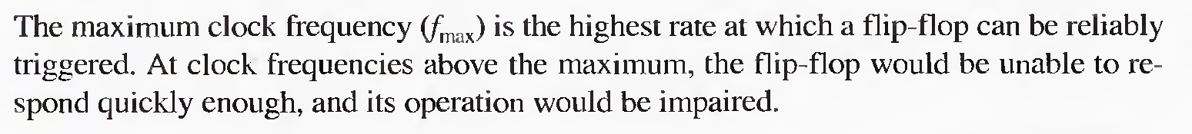

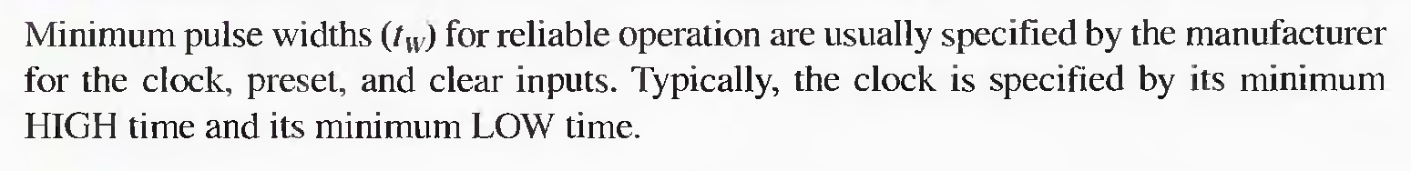

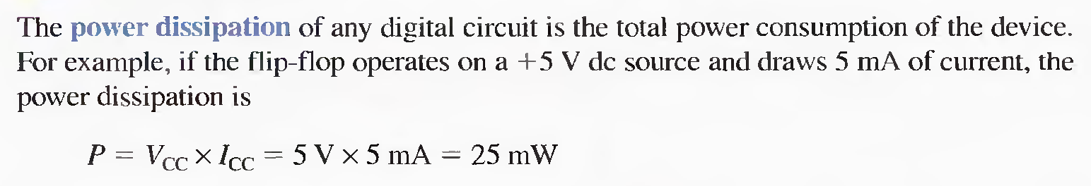

Slide 10

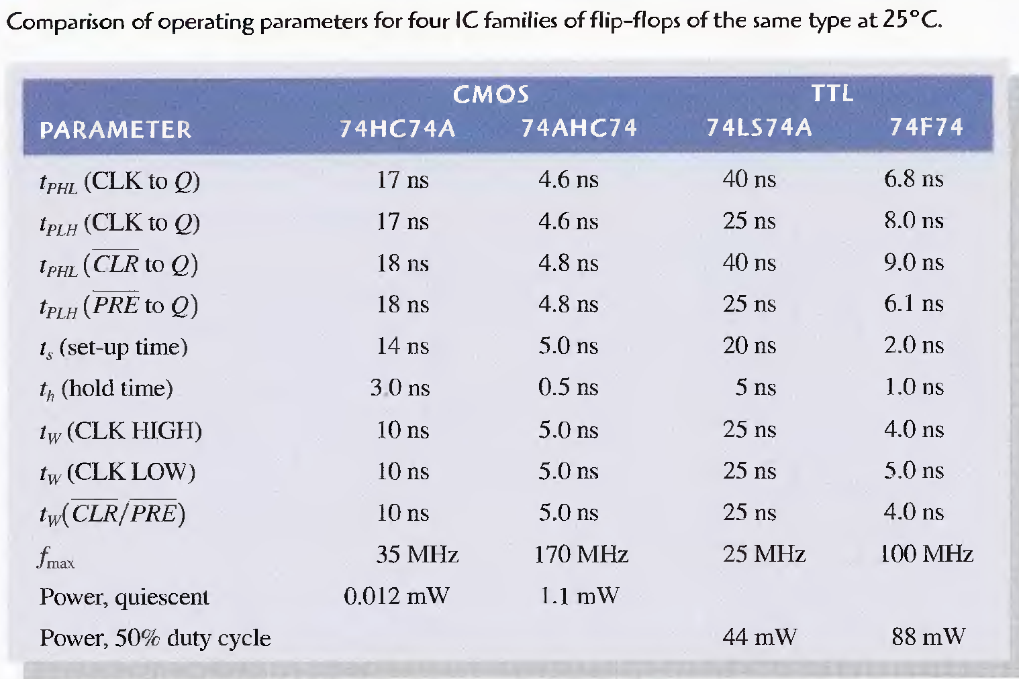

Slide 11


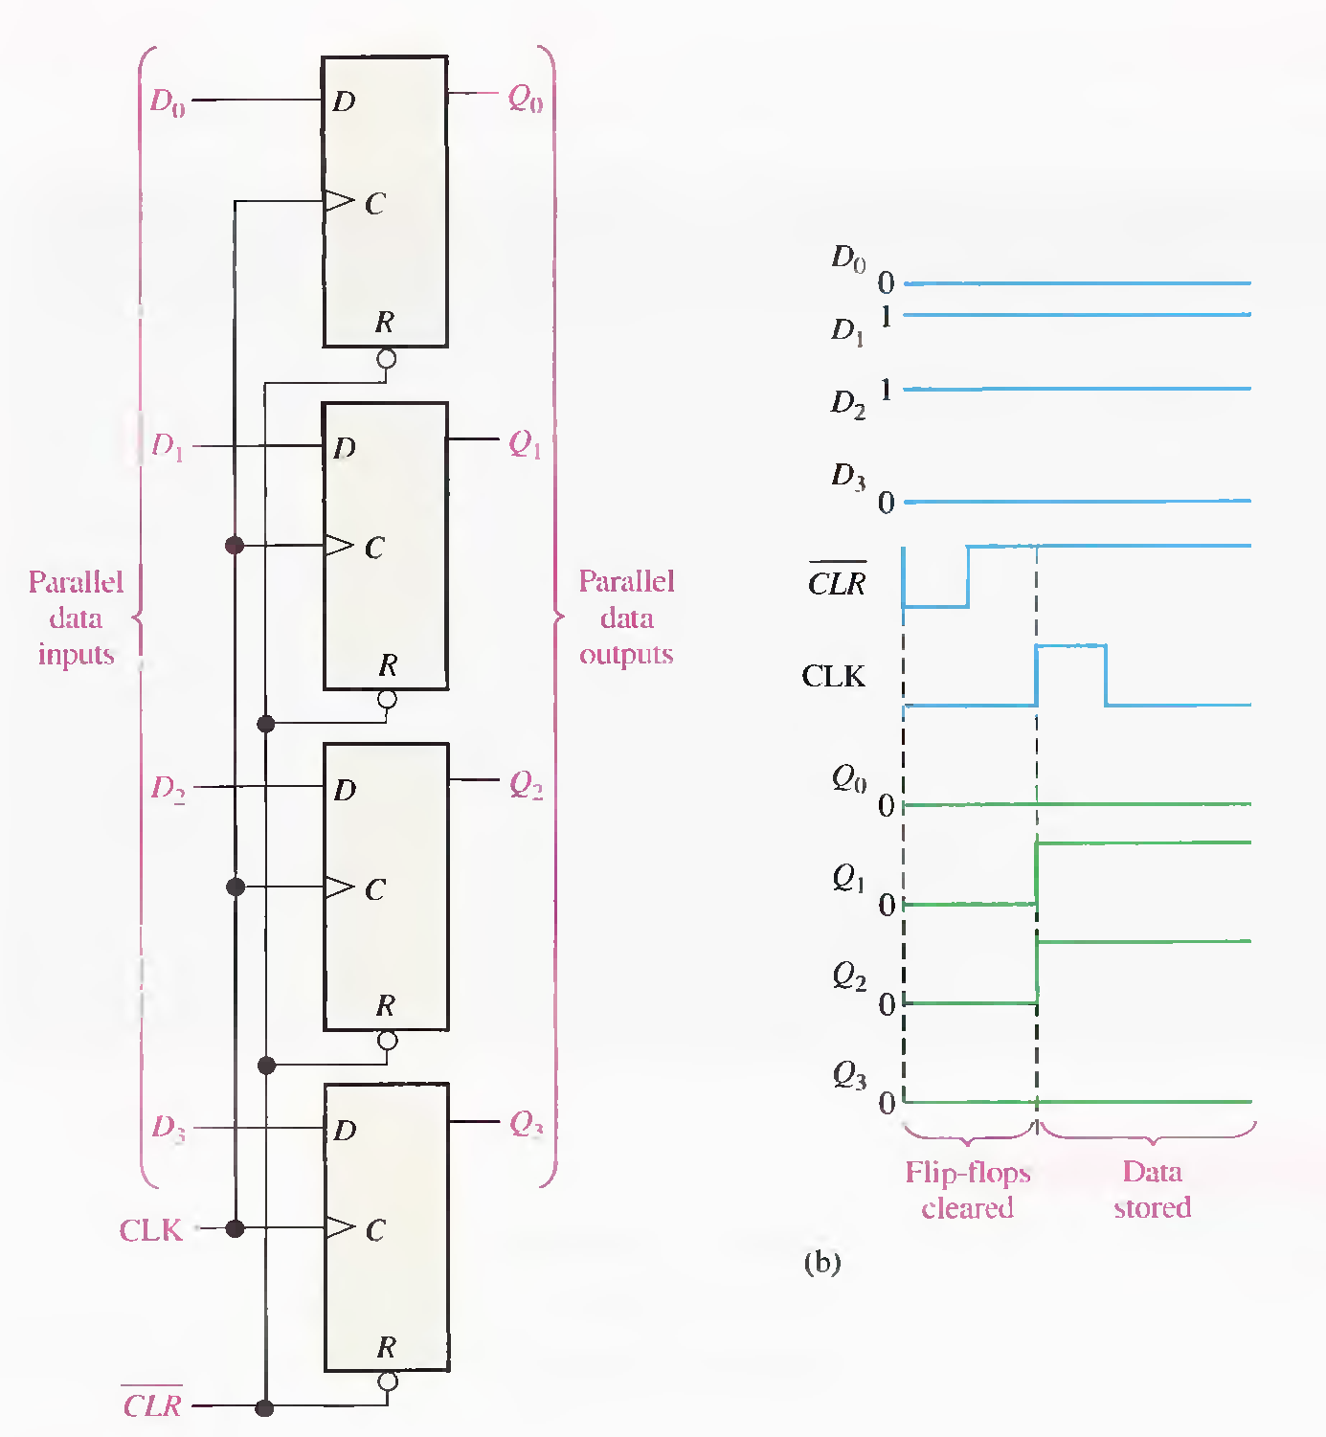

Slide 12
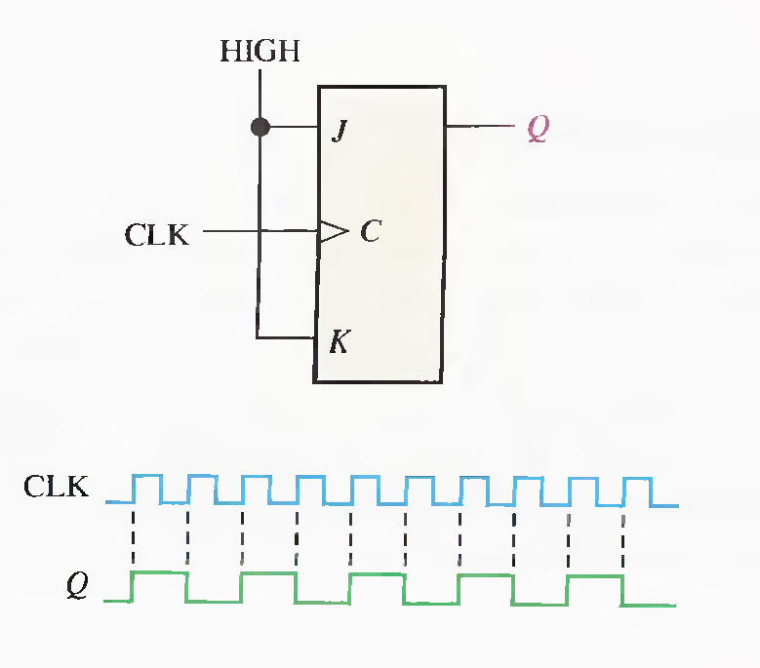

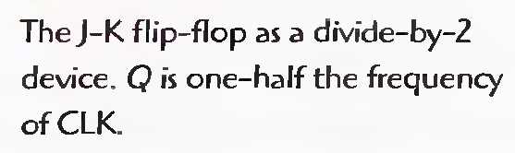
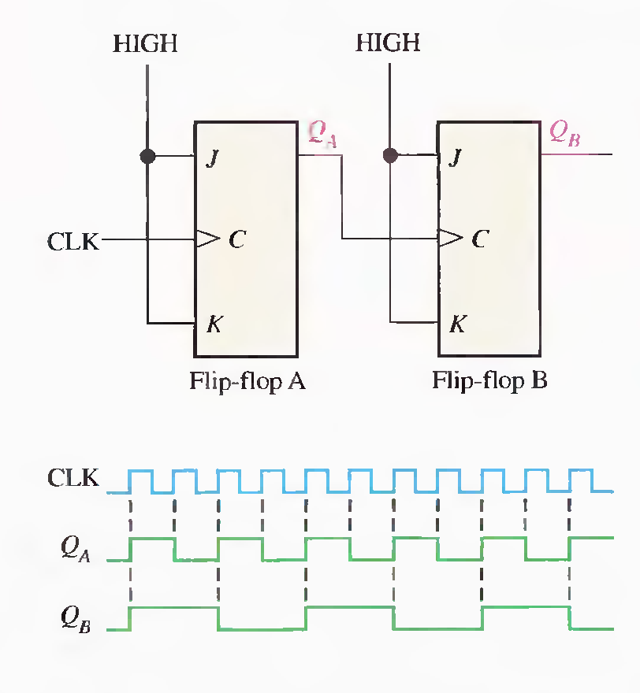
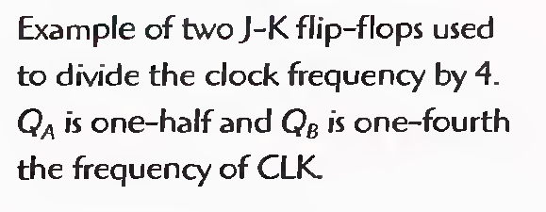

Slide 13

